Slide 1

Amanda Bailey
John Carroll
Mark (Lanxin) Ma
Allison Macdonald
Cesar Sanchez

Slide 2
System Metaphor
Project Horseshoe Farm has requested a webpage that will streamline their online tutoring program.
Tutors
Password Lock
Student Tutoring Schedule
View Student Info
Join Session When Ready
Students
No Password
Notifications
Simple Navigation
Progress via Horseshoes
Tutor for the Day
Math via Khan & PDF
Reading Via Kindle
Admins
Password Lock
Table of Students & Tutors
View Student Info
View Tutor Info
Match Students and Tutors

Slide 3
Cycle Objectives
Learn web development
Build page framework
Implement login functionality for students, tutors, and admins

Slide 4
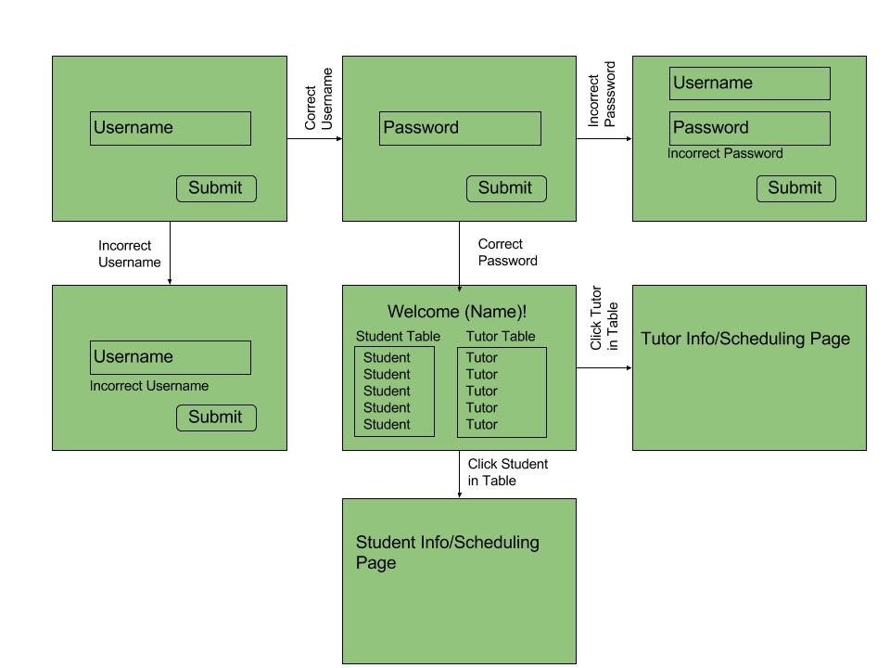
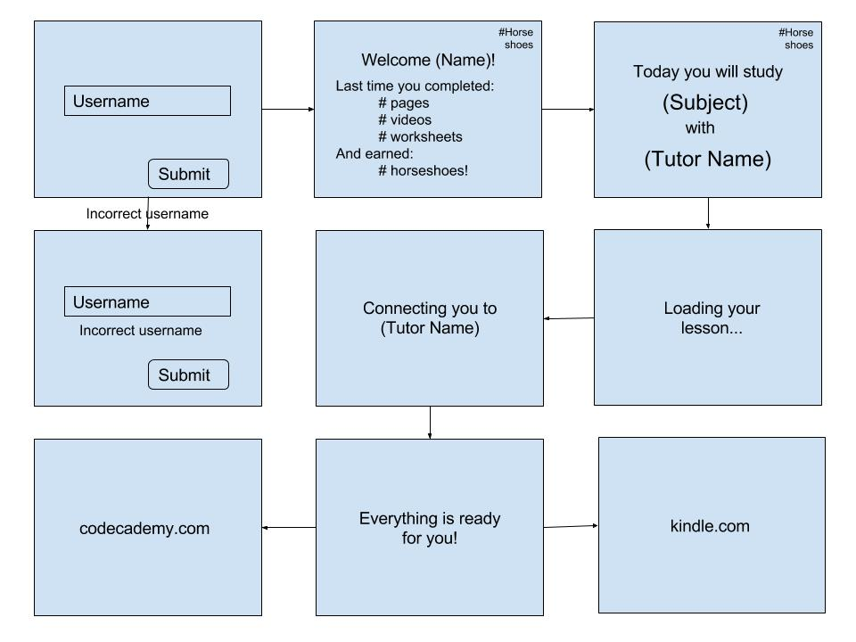
User Stories
Student
Admin
khanacademy.com

Slide 5
Technical Challenges
Limited experience with web development on the team
Highly restrictive schedules hinders meetings
Difficulty setting up some software, such as WAMP

Slide 6
Design Description
Simple page layouts for users
Built with Bootstrap framework
HTML files built for a single task
One JavaScript file per HTML file
CSS for page styles
JQuery to listen for page events
PHP unimplemented (for now)
Front-end built with Apache, PHP, and MySQL

Slide 7
Product Demonstration

